Slide 2
HyperLINQ
Take your LINQ skills to the next level

Slide 3
Mark Heath
Software developer & cloud architect @ NICE Systems
Pluralsight Author
Microsoft MVP
@mark_heath | https://markheath.net

Slide 4

@mark_heath | https://markheath.net

Slide 5

Notes:
Party like its 2007!

Slide 6
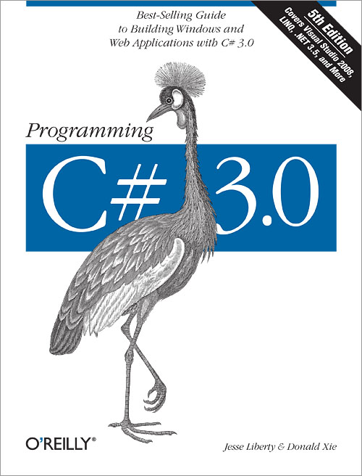
data.Where(x => x % 2 == 1) .OrderBy(x => x) .Select(x => x * x);
Notes:
Extension methods and lambdas

Slide 7
var query = data.Select(x => new { Square = x * x, Cube = x * x * x });
Notes:
Anonymous types and var keyword

Slide 8
from x in data where x % 2 == 1 orderby x descending select x * x;
Notes:
SQL Like Query Language

Slide 9

“Give me six hours to chop down a tree and I will spend the first four sharpening the axe”
Abraham LINQ’n

Slide 10

“Lunchtime LINQ Challenge”
https://markheath.net/category/linq-challenge

Slide 11
Tip #1
Use LINQPad
https://www.linqpad.net

Slide 12

Tip #1 – Use LINQPad
https://www.linqpad.net

Slide 13
Tip #2
Notice patterns

Slide 14
var customersToEmail = new List<Customer>();
foreach (var customer in customers)
{
if (!String.IsNullOrEmpty(customer.Email))
{
customersToEmail.Add(customer);
}
}
customers .Where(c => !String.IsNullOrEmpty(c.Email)) .ToList();

Slide 15
string beginsWithT = null;
foreach (var name in names)
{
if (name.StartsWith("T"))
{
beginsWithT = name;
break;
}
}
Imperative
(How)
Declarative (What)
var beginsWithT = names.FirstOrDefault(n => n.StartsWith("T"));

Slide 16
var names = new string[] { "Ben", "Lily", "Joel", "Sam", "Annie" };
int longestName = 0;
foreach (var name in names)
{
if (name.Length > longestName)
{
longestName = name.Length;
}
}
Imperative
(How)
Declarative (What)
int longestName = names.Max(n => n.Length);

Slide 17
Tip #3
Use Pipelines

Slide 18
var result = DoLast(DoThird(DoSecond(DoFirst(data)));
var temp1 = DoFirst(data);
var temp2 = DoSecond(temp1);
var temp3 = DoThird(temp2);
var result = DoLast(temp3);
let result = data |> DoFirst |> DoSecond
|> DoThird
|> DoLast
var result = data.DoFirst() .DoSecond()
.DoThird()
.DoLast();

Slide 19
// in a motor sport competition, a player's points total
// for the season is the sum of all the points earned in
// each race, but the three worst results are not counted
// towards the total. Calculate the following player's score
// based on the points earned in each round:
"10,5,0,8,10,1,4,0,10,1"
.Split(',')
.Select(s => int.Parse(s))
.OrderBy(n => n)
.Skip(3)
.Sum()
Notes:
Lots of stages, composable

Slide 20

LINQ STINQ #1
Complex Pipelines

Slide 21
File.ReadAllLines("data.txt")
.Skip(1)
.Select(x => x.Split('\t'))
.Where(x => x.Length > 1 && x[1].Trim().Length > 0)
.SelectMany(x => x[1].Split(';'))
.Select(x => x.Trim())
.OrderBy (x => x)
.ToList();
Notes:
Hard to understand the big picture. Hard to debug intermediate values (there are ways)

Slide 22
customers
.Where(IsEligibleForDiscount)
.Select(GetDiscountPercentage)
Notes:
Much easier to understand what’s going on -

Slide 23
Tip #4
Extend LINQ

Slide 24
orders
.Select((item, index) => new { item, index })
.GroupBy(x => x.index / 10)
.Select(g => g.Select(x => x.item).ToArray())
orders
.Batch(10)
Notes:
Clean code

Slide 25
public static class MyExtensions
{
public static IEnumerable<T[]> Batch<T>(
this IEnumerable<T> source, int size) {
var tmp = new List<T>();
foreach (var item in source) {
tmp.Add(item);
if (tmp.Count == size) {
yield return tmp.ToArray();
tmp.Clear();
}
}
if (tmp.Count > 0)
yield return tmp.ToArray();
}
}
Notes:
Extension Methods: Unit testable, performance tunable, static class, this keyword, generic, yield keyword

Slide 26
Tip #5
Use MoreLINQ
https://morelinq.github.io/

Slide 27

https://markheath.net/category/morelinq
MaxBy, Permutations, Subsets, Cartesian, Scan, TakeEvery, TakeLast, Batch, FallbackIfEmpty, Interleave, Pad, Random, Shuffle, Slide, Window, Pairwise, CountBy, GroupAdjacent, Segment, Generate, Repeat, ToDelimitedString, Pipe, ForEach, Insert, Union, LeftJoin, RightJoin, TraverseBreadthFirst, ...

Slide 28
MoreLINQ Demo
MaxBy

Slide 29
MoreLINQ Demo
Pairwise

Slide 30
Tip #6
Understand Deferred Execution

Slide 31
void Main()
{
var messages = GetMessages();
Console.WriteLine(messages.First());
}
IEnumerable<string> GetMessages()
{
yield return "Hello";
Thread.Sleep(5000);
yield return "World";
throw new Exception("Blah");
}
Notes:
Q – What gets written? Deferred execution, don’t start until you need to

Slide 32
LINQ STINQ #2
Reading too much

Slide 33
var blobs = GetBlobs("MyContainer").ToList(); var blob = blobs.First(b => b.Name.EndsWith(".txt"));
Console.WriteLine(blob.Name);
IEnumerable<Blob> GetBlobs(string containerName)
{
// ??? }
Notes:
Don’t do more work than you need to. ToList()

Slide 34
LINQ STINQ #3
Multiple enumeration

Slide 35
var blobs = GetBlobs("MyContainer"); var biggest = blobs.MaxBy(b => b.Size); var smallest = blobs.MinBy(b => b.Size);
Notes:
Potentially different results, duplicate work

Slide 36
var blobs = GetBlobs("MyContainer").ToList(); var biggest = blobs.MaxBy(b => b.Size); var smallest = blobs.MinBy(b => b.Size);
Notes:
ToList()

Slide 37
LINQ STINQ #5
Inefficient SQL

Slide 38
Albums
.Where(a => a.Artist.Name.StartsWith("A"))
.OrderBy(a => a.Artist.Name)
.Select(a => new { Artist = a.Artist.Name, Album = a.Title })
.Take(5)
DECLARE @p0 NVarChar(1000) = 'A%'
SELECT TOP (5) [t1].[Name] AS [Artist], [t0].[Title] AS [Album]
FROM [Album] AS [t0]
INNER JOIN [Artist] AS [t1] ON [t1].[ArtistId] = [t0].[ArtistId]
WHERE [t1].[Name] LIKE @p0
ORDER BY [t1].[Name]

Slide 39
Albums
.Where(a => a.Artist.Name.Count(c => c == ' ') > 2)
.OrderBy(a => a.Artist.Name)
.Select(a => new { Artist = a.Artist.Name, Album = a.Title })
.Take(5)
Notes:
Do as Demo in LINQPad Can’t be done as a list

Slide 40
context.Database.Log = Console.WriteLine;
DbContextOptionsBuilder.UseLoggerFactory(myLoggerFactory)
Notes:
https://docs.microsoft.com/en-us/ef/core/miscellaneous/logging

Slide 41
“LINQ is the gateway drug to functional programming”
Phil HaaQ
Notes:
https://haacked.com/archive/2009/02/15/the-functional-language-gateway-drug.aspx/

Slide 42
LINQ STINQ #4
Side Effects

Slide 43
Functional Programming Big Ideas
Declarative code
Higher order functions
Pipelines
Immutable objects
Pure functions
Notes:
https://www.markheath.net/post/functional-programming-big-ideas

Slide 44
Pure Functions
Input objects
are not
mutated
Output depends
on inputs only
λ
No “side-effects”
Same inputs
always yield
same output
Network
Global
variables
Database
Notes:
Highly testable, exception to the rule? Tracing

Slide 45
orders .Select(o => { o.IsCancelled = true; return o; }) .ToList();
orders .ToList() .ForEach(o => o.IsCancelled = true);
orders .ForEach(o => o.IsCancelled = true);
foreach (var o in orders)
{
o.IsCancelled = true;
}
Notes:
Mutating, MoreLINQ ForEach on Ienumerable<T>, not a sin to use foreach keyword

Slide 46
var client = new HttpClient();
var urls = new [] { "https://www.alvinashcraft.com/",
"http://blog.cwa.me.uk/",
"https://codeopinion.com/"};
var regex = @"<a\s+href=(?:""([^""]+)""|'([^']+)').*?>(.*?)</a>";
urls.Select(u => client.GetStringAsync(u).Result)
.SelectMany(h => Regex.Matches(h, regex).Cast<Match>())
.Where(m => m.Value.Contains("markheath.net"))
.Select(m => m.Value)
.ToList()
.ForEach(l => Console.WriteLine(l));
Notes:
Is this bad – not downloading in parallel, ugly .Result, likely to encounter exceptions

Slide 47
Directory.EnumerateFiles(@"C:\Code",
"*.cs", SearchOption.AllDirectories))
.Sum(f => File.ReadAllLines(f).Length });
Notes:
Is this bad? It’s a side effect

Slide 48
files .Select(f => CopyFileAsync(f.Name, destFolder)) .ToList();
Notes:
Starting threads, what’s wrong with this?

Slide 49
Tip #7
Know both syntaxes

Slide 50

8
7
6
5
4
3
2
1
A
B
C
D
E
F
G
H

Slide 51
Enumerable.Range('a', 8)
.SelectMany(x => Enumerable.Range('1', 8),
(r, c) => new { r, c })
.Select(x => new { x.r, x.c,
dx = Math.Abs(x.r - 'c'),
dy = Math.Abs(x.c - '6') })
.Where(x => x.dx == x.dy && x.dx != 0)
.Select(x => $"{(char)x.r}{(char)x.c}"));
Notes:
SelectMany, anonymous objects

Slide 52
from row in Enumerable.Range('a', 8)
from col in Enumerable.Range('1', 8)
let dx = Math.Abs(row - 'c')
let dy = Math.Abs(col - '6')
where dx == dy
where dx != 0
select $"{(char)row}{(char)col}"
Notes:
It's good at SelectMany, It's good when you need to hang onto intermediate variables

Slide 53
Tip #8
Performance matters

Slide 54
var sum = Enumerable.Range(1, 10000000)
.Select(n => n * 2)
.Select(n => Math.Sin((2 * Math.PI * n)/1000))
.Select(n => Math.Pow(n,2))
.Sum();
.AsParallel()
double sum = 0; for (int n = 1; n <= 10000000; n++)
{
var a = n * 2;
var b = Math.Sin((2 * Math.PI * a)/1000);
var c = Math.Pow(b,2);
sum += c;
}
Notes:
Profile (properly!), consider size of datasets, CPU vs IO Bound, MoreLINQ Batch

Slide 55
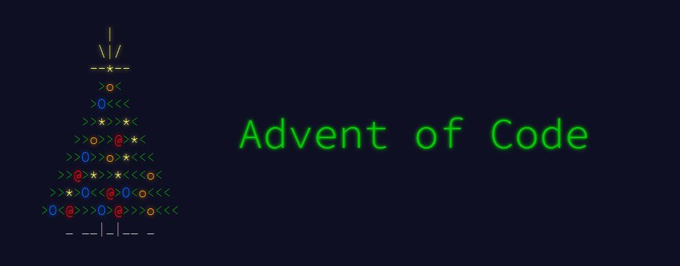
https://adventofcode.com/

Slide 56
@mark_heath | https://markheath.net

